Slide 1
Intern Project Report Prepared by: Huiyi Zhang Date: Sep.15

Slide 2

Company Introduction
Porter started out as a platform designed to address last-mile logistics industry inefficiencies. Its creative methodology has revolutionized the movement of goods throughout urban areas, offering companies a dependable, on-demand logistics solution. Porter has revolutionized urban logistics by enabling thousands of firms to transfer goods fast and efficiently by improving urban freight movement.

Slide 3
Problem Statement
In the highly competitive market environment, Porter needs to precisely identify and target potential customer segments to design an effective marketing campaign. The goal of this campaign is to increase the order conversion rate, expand the product line, and ultimately enhance the company's profits.
To achieve this, the following key questions need to be solved:
Customer Segmentation
Market Positioning
Marketing Strategy Development
Performance Evaluation

Slide 4
Scope and Objective
Scope
Objective
Customer Data Analysis:
Analyze existing customer data to segment the customer base into distinct groups based on purchasing patterns, profitability, and potential for growth.
Identify high-value targets for the campaign.
Increase Order Conversion Rate:
Aim to increase the order conversion rate by a specific percentage within a defined period.
Focus on conversion optimization strategies such as personalized marketing, improved customer interactions, and enhanced online experience.

Slide 5
Method
Lead Scoring and Prioritization
Lead scoring involves assigning a value to each lead based on their potential to become a customer. Data analytics plays a crucial role in this by:
Collecting Data: Gathering information from various sources like website interactions, email engagement, social media activity, and past purchase behavior.
Feature Engineering: Identifying and creating relevant features (e.g., job title, industry, company size) that influence lead quality.
Modeling: Using machine learning models to predict the likelihood of a lead converting into a customer based on historical data.
Scoring: Assigning a score to each lead, which helps in prioritizing them for follow-up actions.
Tools will be used: Excel, Python

Slide 6
Key Features
Source
Status
Geo Region
Source Detail
Disposition
Drop Geo Region
Platform
Scoring Methodology:
Assign scores to each category based on their impact on lead conversion. Higher scores should be given to features that have a stronger positive correlation with successful conversions.
Normalize the scores across different features to make them comparable.

Slide 7
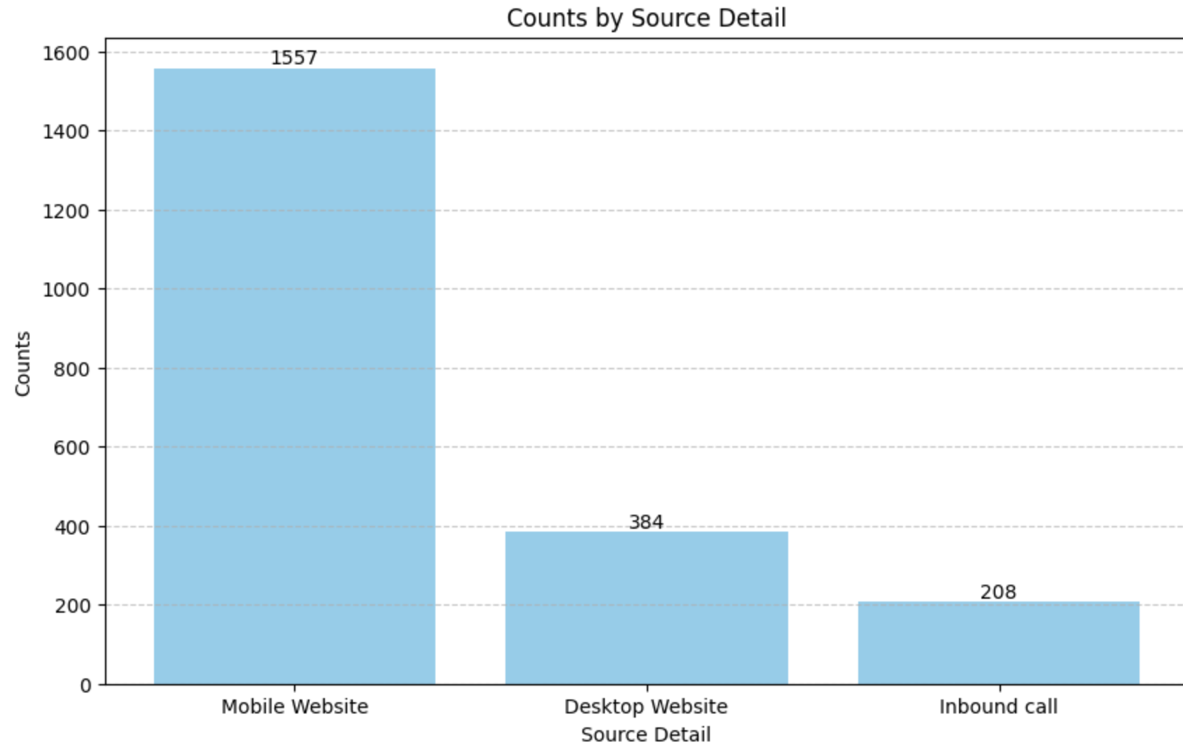
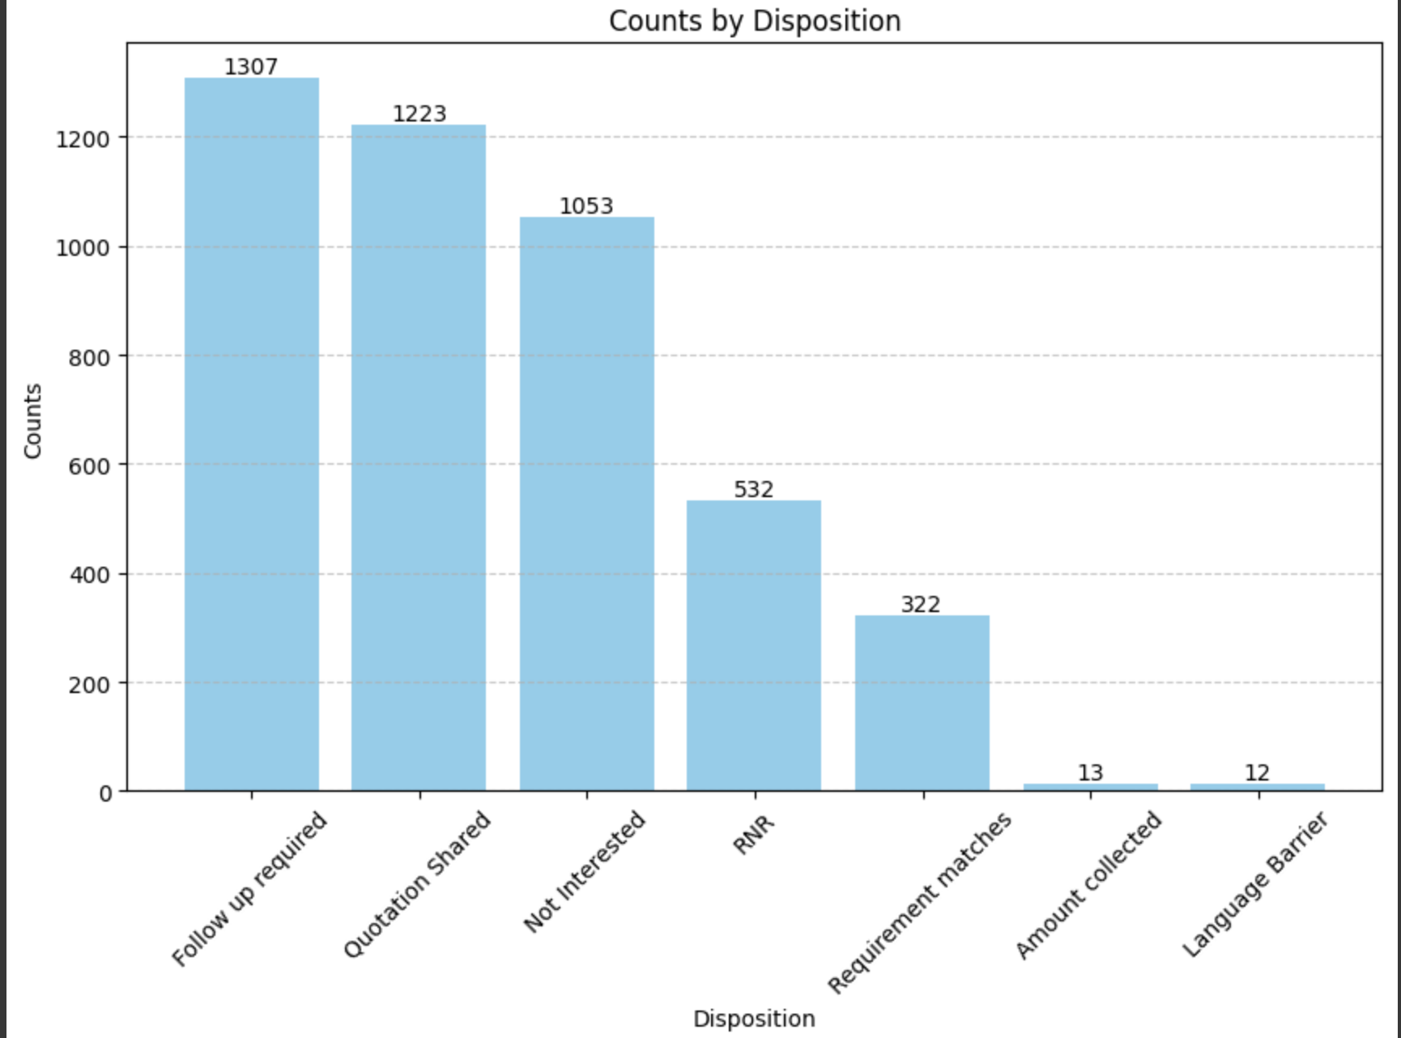
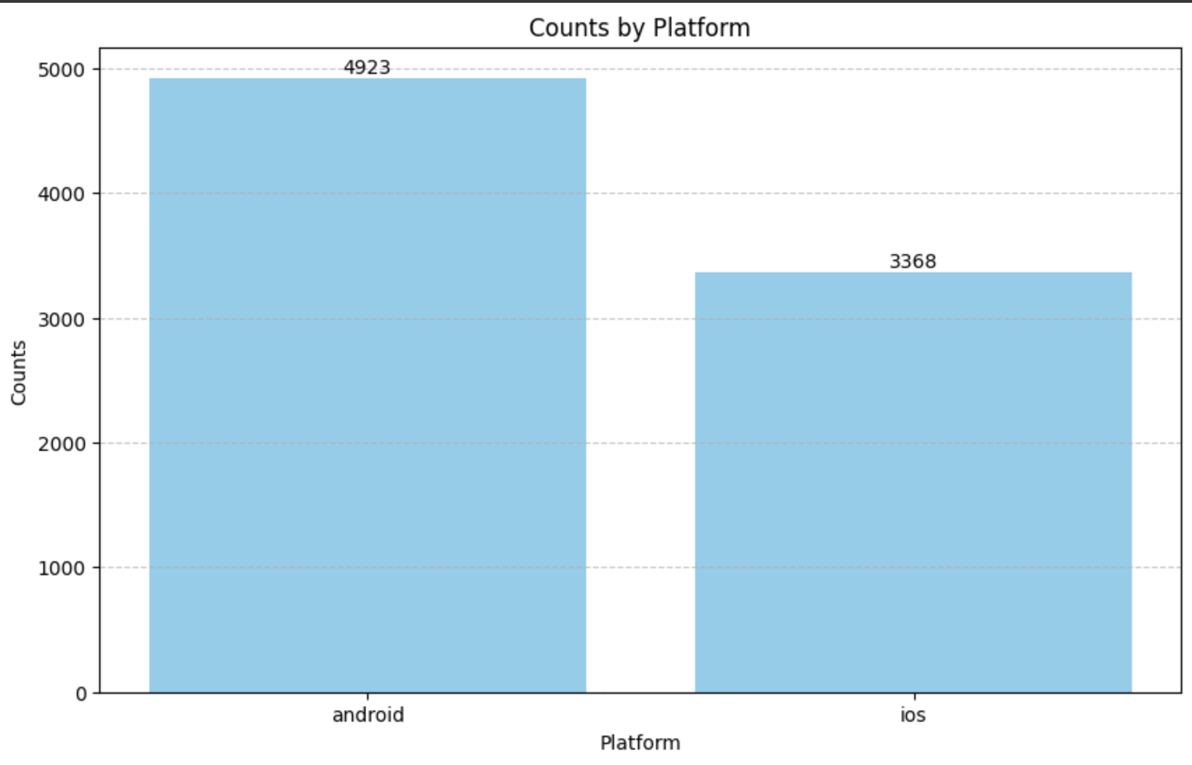
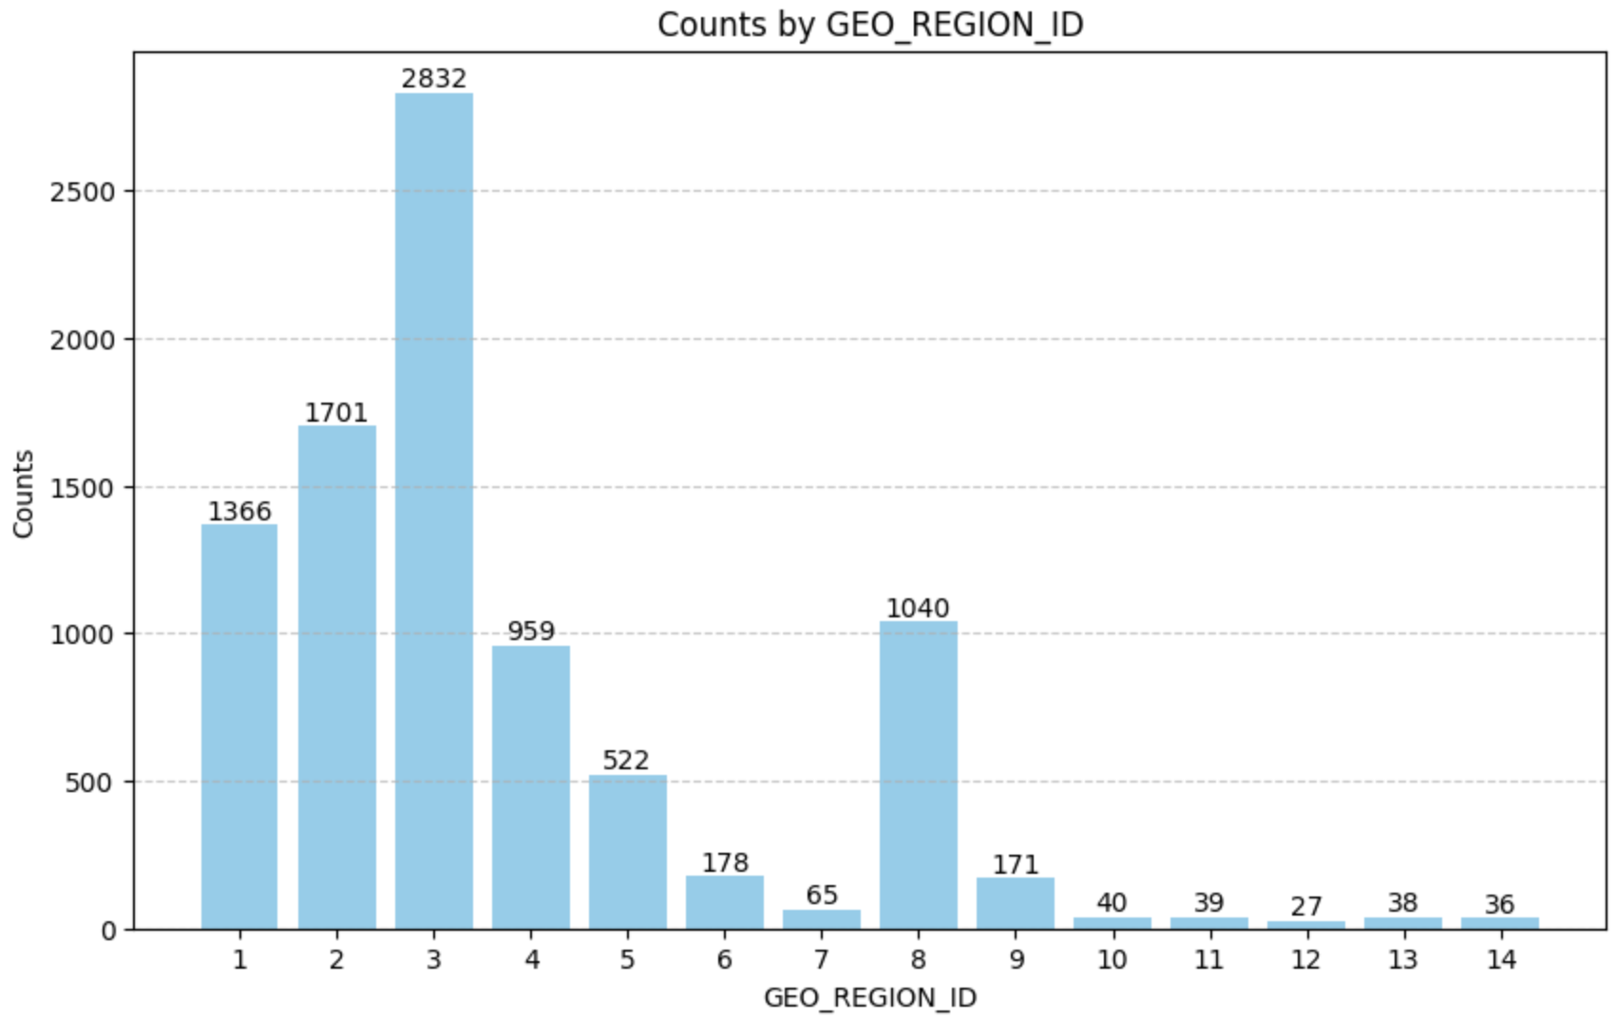
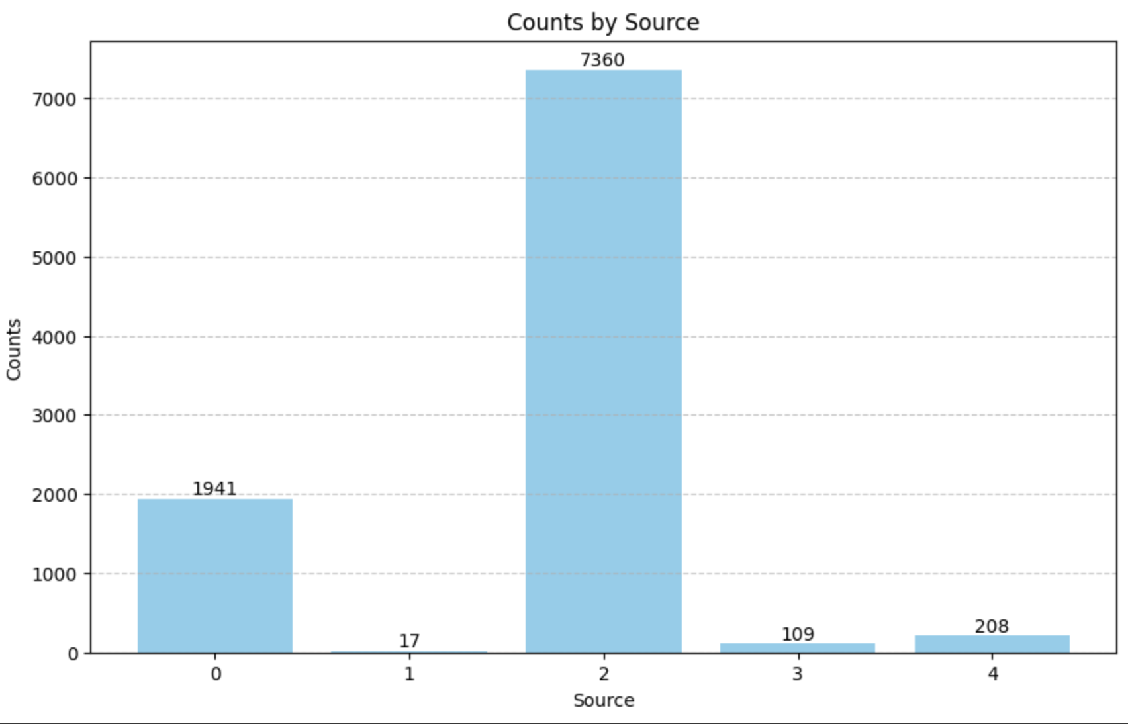
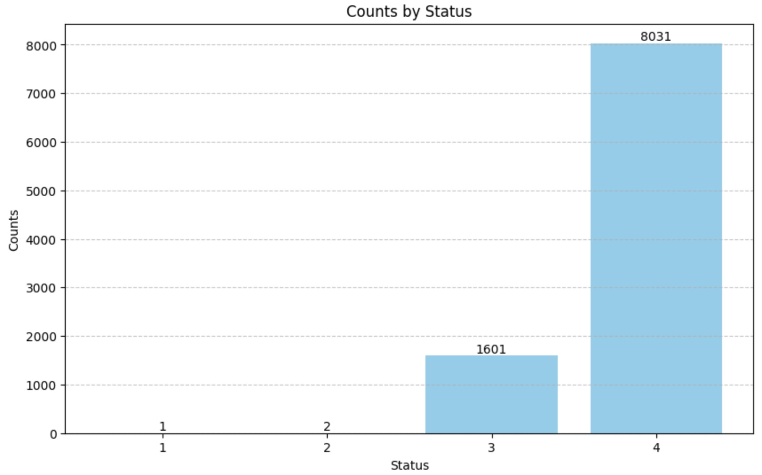
Coding Display

Slide 8
Next Step
Apply linear regression to find coefficients and significant relationship
Linear Regression Setup: Use a statistical software or a programming library (like Python's scikit-learn) to set up the linear regression model.
Fitting the Model: Apply the linear regression algorithm to the training data to estimate the coefficients (β\betaβ).
Analysis of Coefficients
- Coefficient Values: Review the estimated coefficients from the regression output. Each coefficient quantifies the relationship between that feature and the outcome, assuming other variables are held constant.Statistical Significance: Look at the p-values associated with each coefficient. A common threshold for significance is p<0.05p < 0.05p<0.05, indicating that there is only a 5% chance that the coefficient is zero due to random chance.

Slide 9
Test and Verification
Using various classification models after applying Linear Regression
Decision Tree Classification
Decision trees are useful when you need a model that provides clear rules for classification, or when you want to understand feature importance.
Random Forest Classification
Decision trees are useful when you need a model that provides clear rules for classification, or when you want to understand feature importance.
Support Vector Machine (SVM) Classification
SVM is useful when you have a high-dimensional feature space and when you want a model that works well with both linear and non-linear decision boundaries.
K-Nearest Neighbors (KNN) Classification
KNN is useful for small datasets and situations where you expect local patterns to be important in making classifications.

Slide 10
Conclusion
Source
Status
Geo Region
Source Detail
Disposition
Drop Geo Region
Platform
The analysis of key features within the dataset has provided substantial insights into the dynamics influencing our customer engagement and conversion rates
Key Insights:
1. Source Detail: The analysis highlighted that the mobile website is a critical source detail, bringing in a high volume of quality leads.
2. Platform: Android devices dominate among our user base, making them a primary target for our platform-specific marketing efforts.
3. Geo Region and Drop Geo Region: These features have shown variations in customer response and conversion rates across different regions. Specific regions have emerged as high-potential areas, whereas others, denoted as 'Drop Geo Regions,' have underperformed and require strategic revision in marketing approaches.

Slide 11
Video
You should shoot a 3+ min video demonstrating -
How did you do the project?
Your coding work;
Your project result;
You can record the video on slack.

Slide 12
THANKS

